Slide 1

API for Leap Motion
when navigating websites
Pritesh Chandra 5114F903-5
Wang Lan 5114FG01-7
Wang Chen 5114F022-1

Slide 2
Outline
Motivation
Model
Demonstration
Final Solution
Future Goal

Slide 3

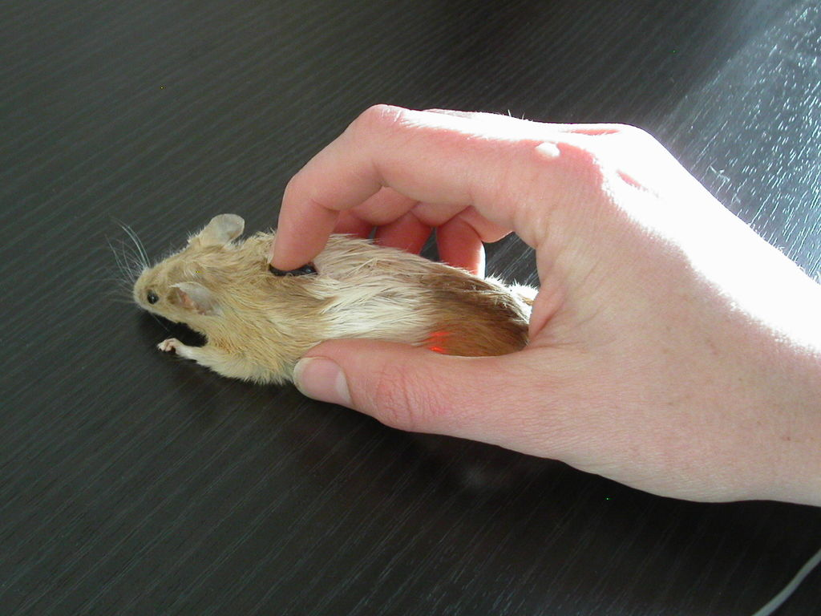
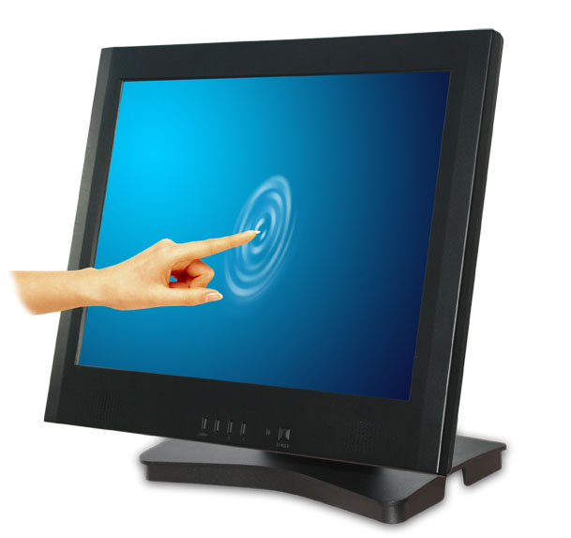
Motivation
In traditional sense, we can browse websites using
Keyboards (Tab and Enter keys),
Mouse (point and click),
Or Touchscreen (point and touch)

Slide 4
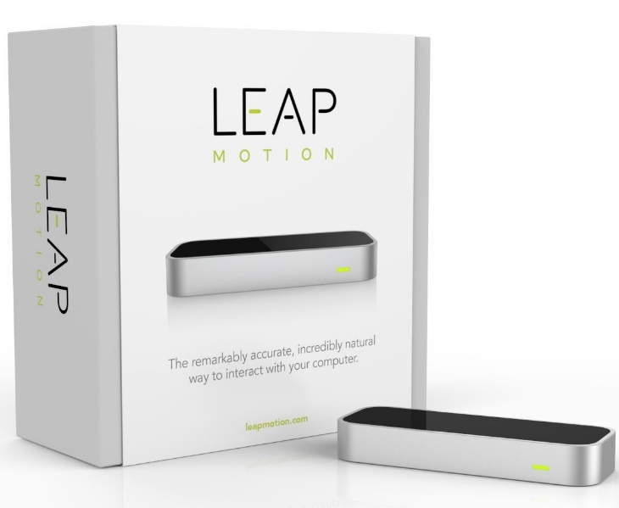
But there is a new player in the market.

Slide 5
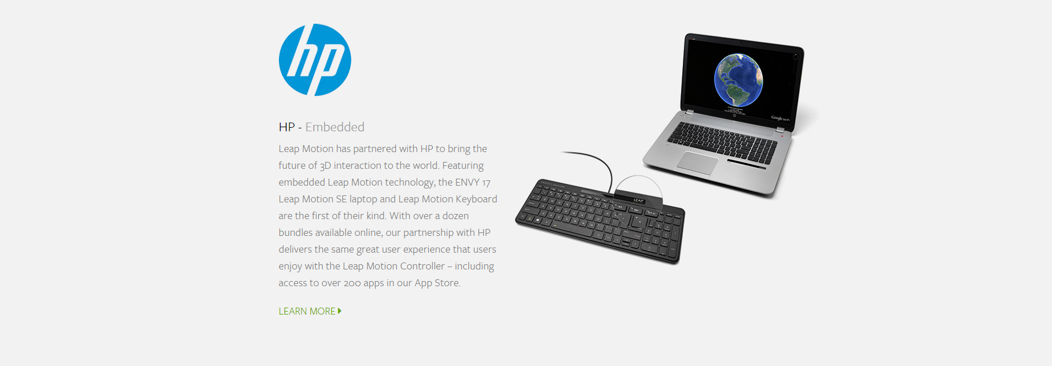

Slide 6
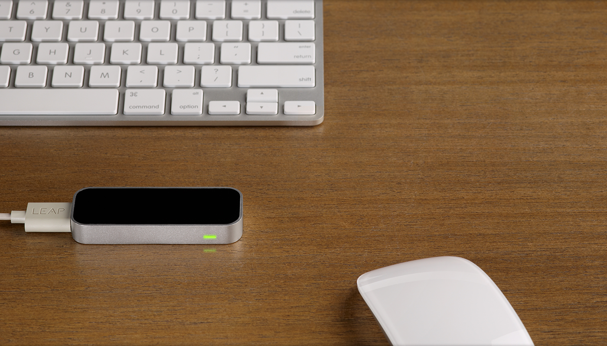
Leap Motion
Leap motion is a sensor device that supports hand and finger motions as input. It is analogous to a mouse but requiring no physical hand contact or touching. Our team has developed an API for leap motion that can be used to navigate websites by hand gestures conveniently.

Slide 7
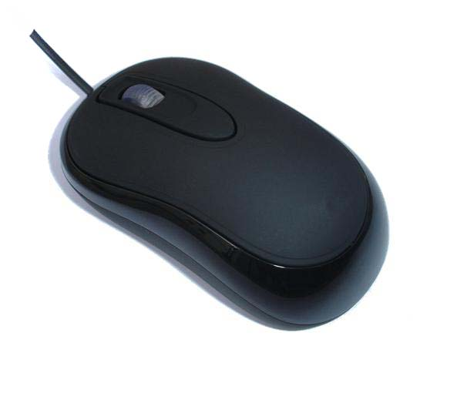
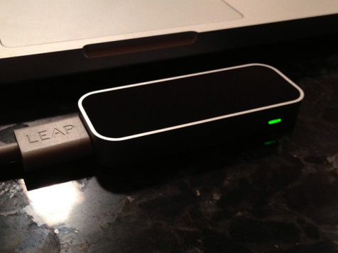
Our API Model
Yamana Lab
Waseda Website
BrowserAPI.js
BrowserAPI.css
Leap Motion Library

Slide 8
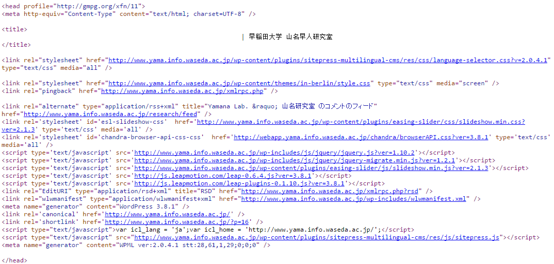
Website example

Slide 9
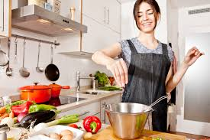
Why Leap Motion?
recipe
Example: You can cook and still use leap motion to browser the recipe website without touching any device.

Slide 10

Why Leap Motion?
Example: Relaxing on the beach using a Leap motion laptop.

Slide 11
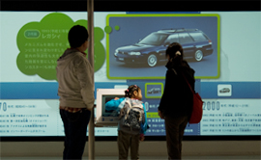
Why Leap Motion?
Example: A display where users can interact more freely without touching (or stealing) the mouse. Leap Motion device can work over glass surface.

Slide 12
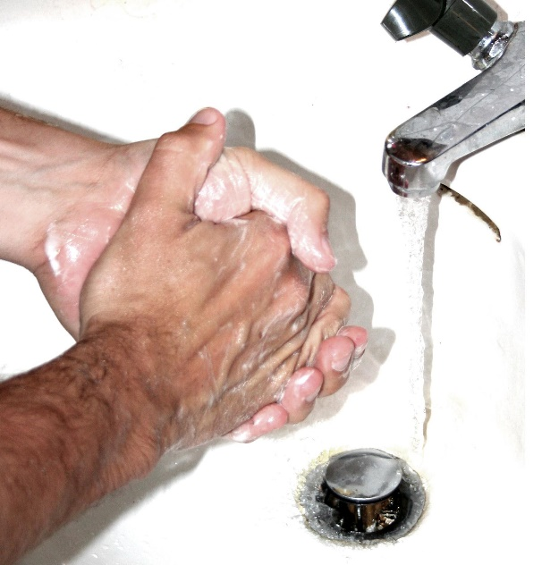
Why Leap Motion?
This form of interaction is applicable in situations where the user’s hands should not touch input devices, such as while cooking or having sweaty hands. This is very useful for people with Obsessive–compulsive disorder (OCD)
Repetitive hand washing is a common OCD symptom

Slide 13
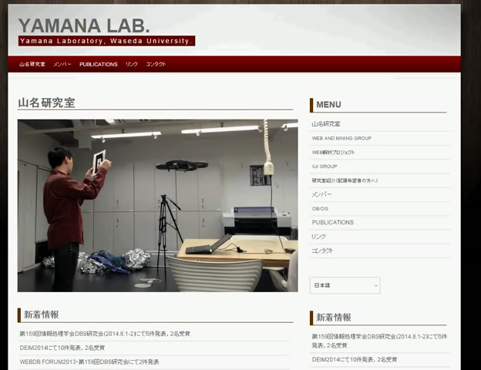
Demonstration

Slide 14
Advantages of API
It is operating system independent. It can be used on Linux, Mac, or Windows.
It is cross browser independent. It works on IE, Firefox, Chrome.
It is easy to implement this API (Just need to embed into the header tags).
No need for any additional programming and no programming knowledge required

Slide 15
Advantages of API
No other special plugin needed.
It is robust, scalable, and light-weight.
To be released under Creative Commons licenses; free so that everyone can download/use/modify/distribute or research further.

Slide 16
Schedule
~Aug. | Sep. | Oct. | Nov. | Dec. | Jan.
on trial
survey
implement
test

Slide 17
Task distribution
Survey
Pritesh Chandra,Wang Lan,Wang Chen
System Design
Pritesh Chandra,Wang Lan,Wang Chen
Implement
Pritesh Chandra,Wang Lan
Test
Wang Chen

Slide 18
Final Solution
We were successful in achieving our target; that the best way to maximize the value of our proposed form of interaction is to develop an API that can be employed and deployed easily.
In our solution, we optimized our JS code several times, making it more concise, lite-weight and easy to implement.
Our goal was to ensure the solution is not bulky, or too difficult to implement. To avoid too many gestures which could confuse the system on what the user is trying to do.
We have tested our solution on 3 different website and all of them has shown promising results.

Slide 19
Future goal
Release this code to public under Creative Commons licenses.
Release it to Leap Motion Community
https://community.leapmotion.com/
Let more people research and improve on this field

Slide 20
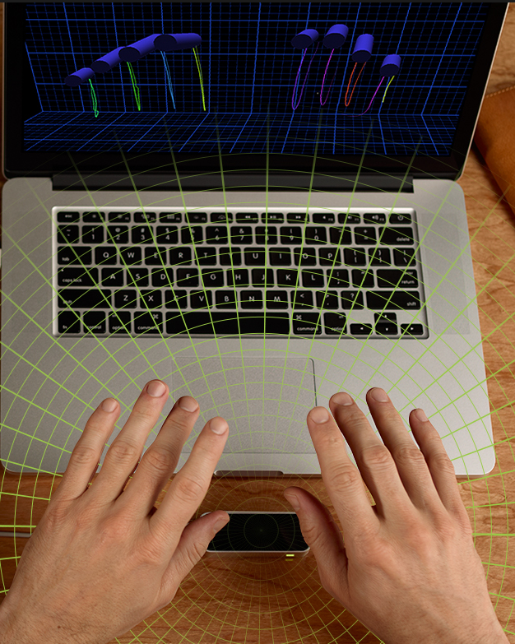
Thank you for your
attention !

